Slide 4
Who Needs an Older Brother?

Slide 6
What did it cost to bring the younger brother home?

Slide 8
“you never gave me even a young goat so I could celebrate”

Slide 10
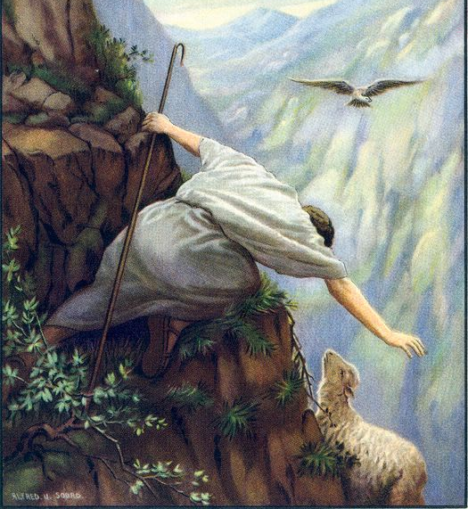

Slide 11
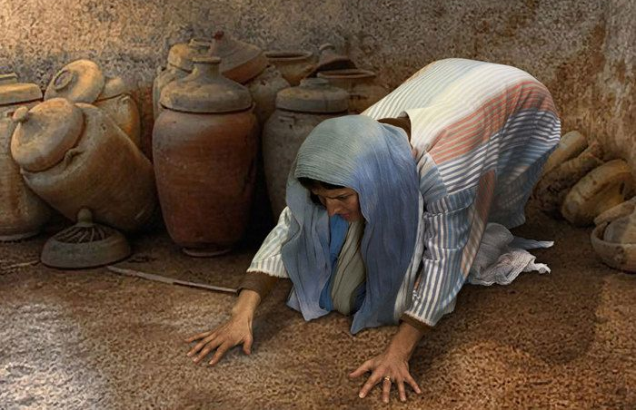

Slide 13
We have a true elder brother.

Slide 15
he gave up everything and became a slave,

Slide 16
Jesus is not ashamed to call them brothers

